Slide 1
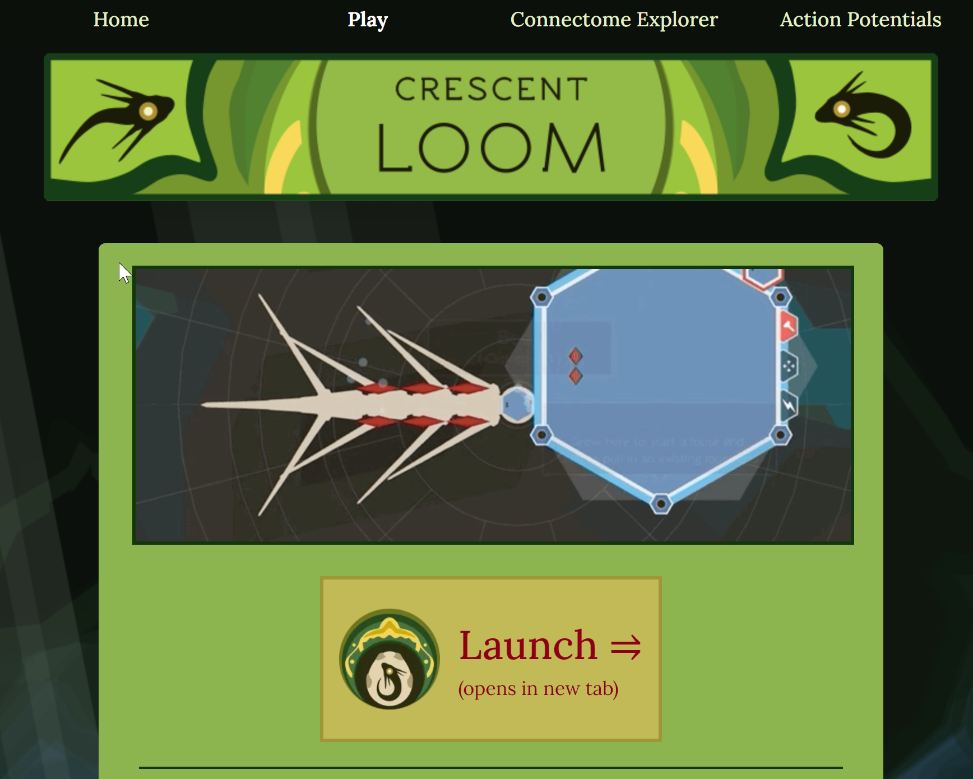
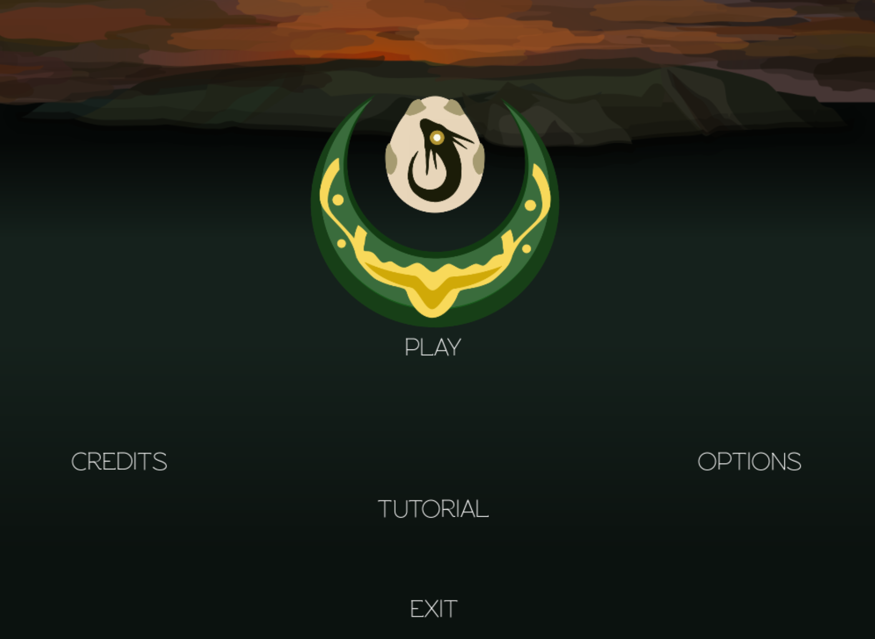
https://crescentloom.com/game
2
1

Slide 2
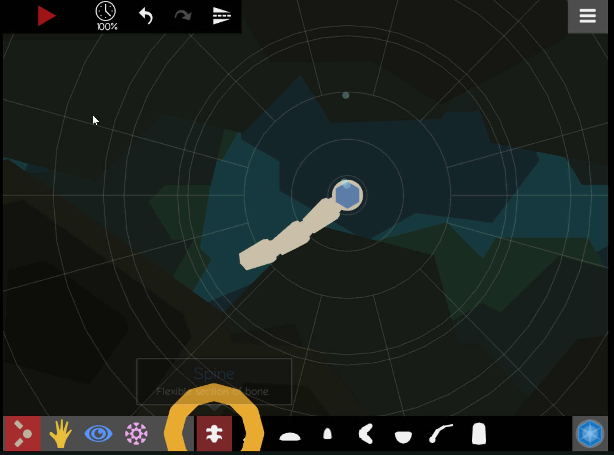
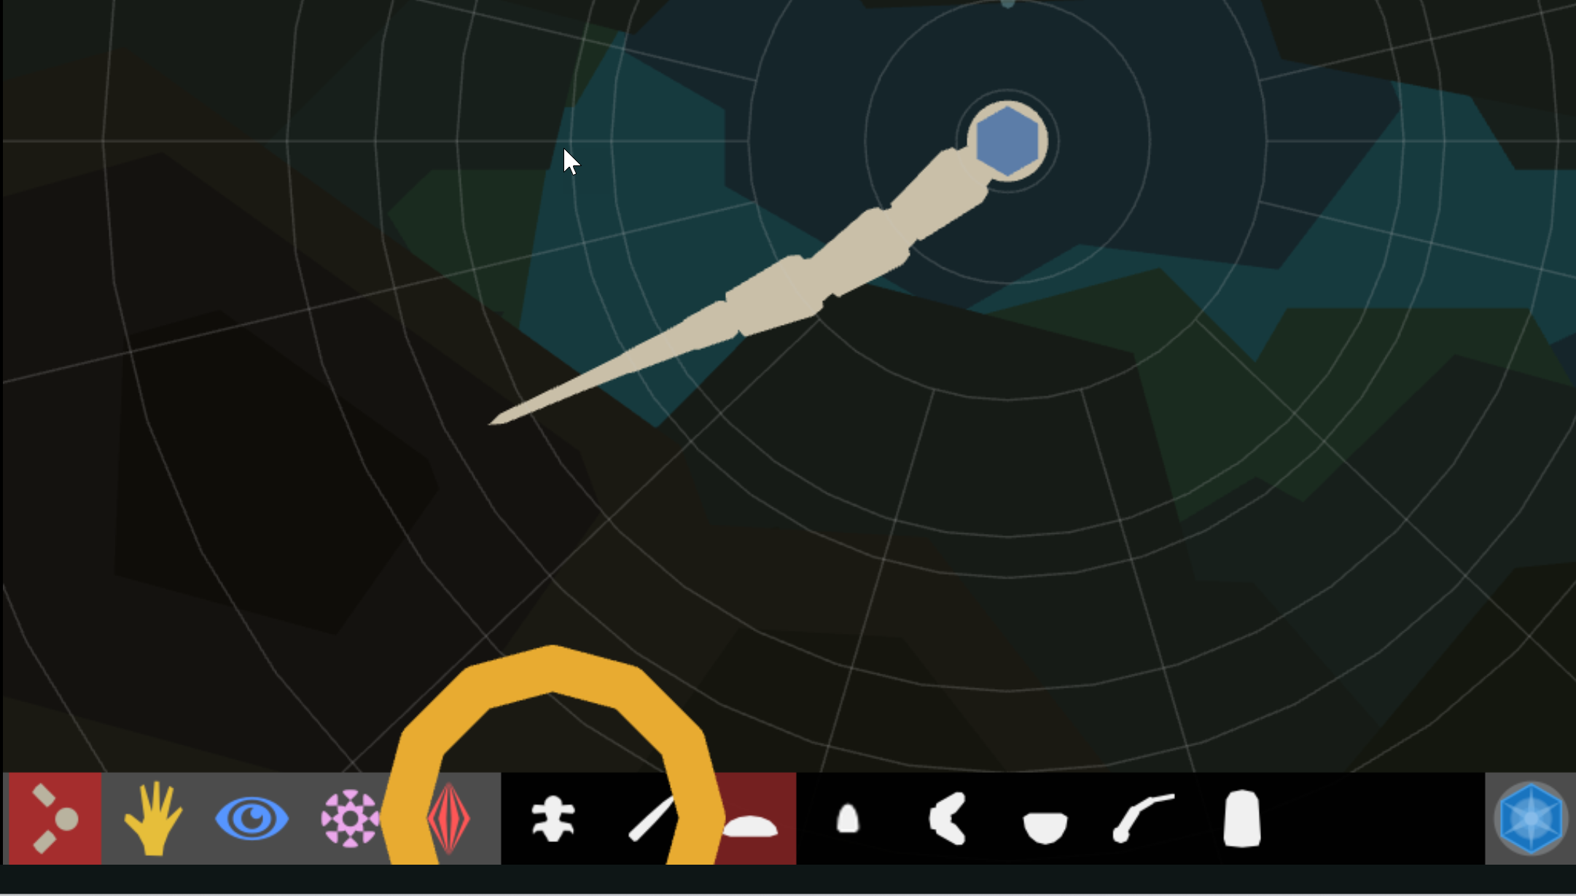
Create a creature
Add spine segments
Add other body parts
3
4

Slide 3
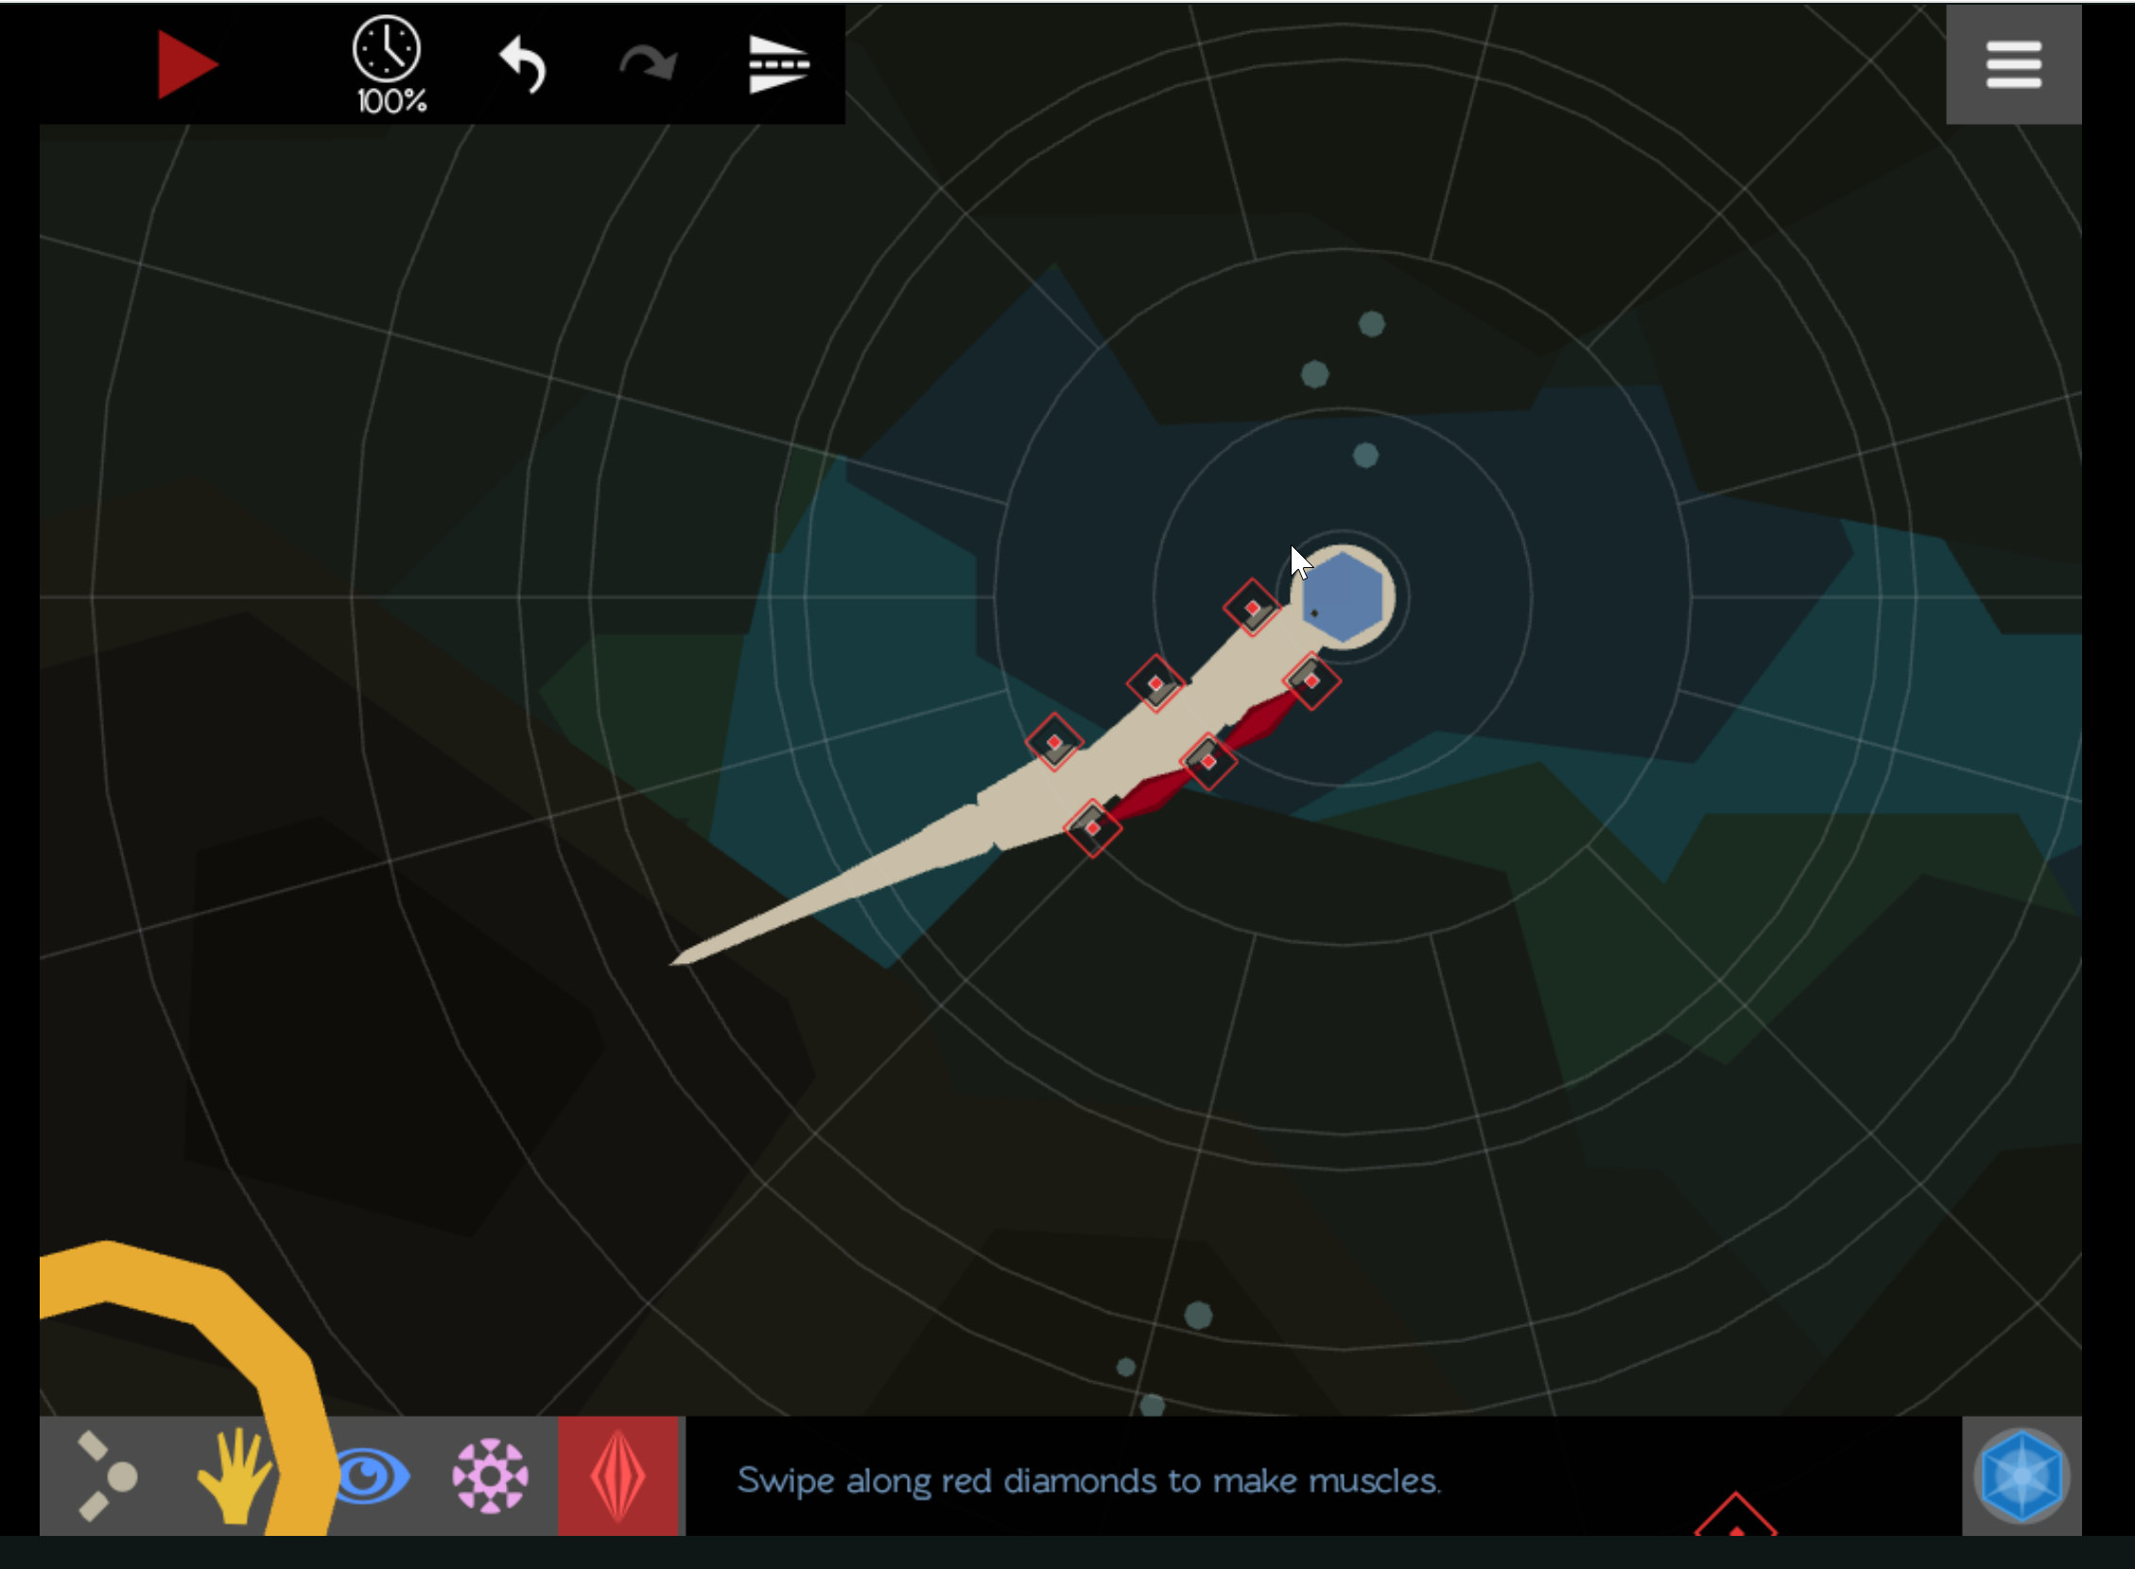
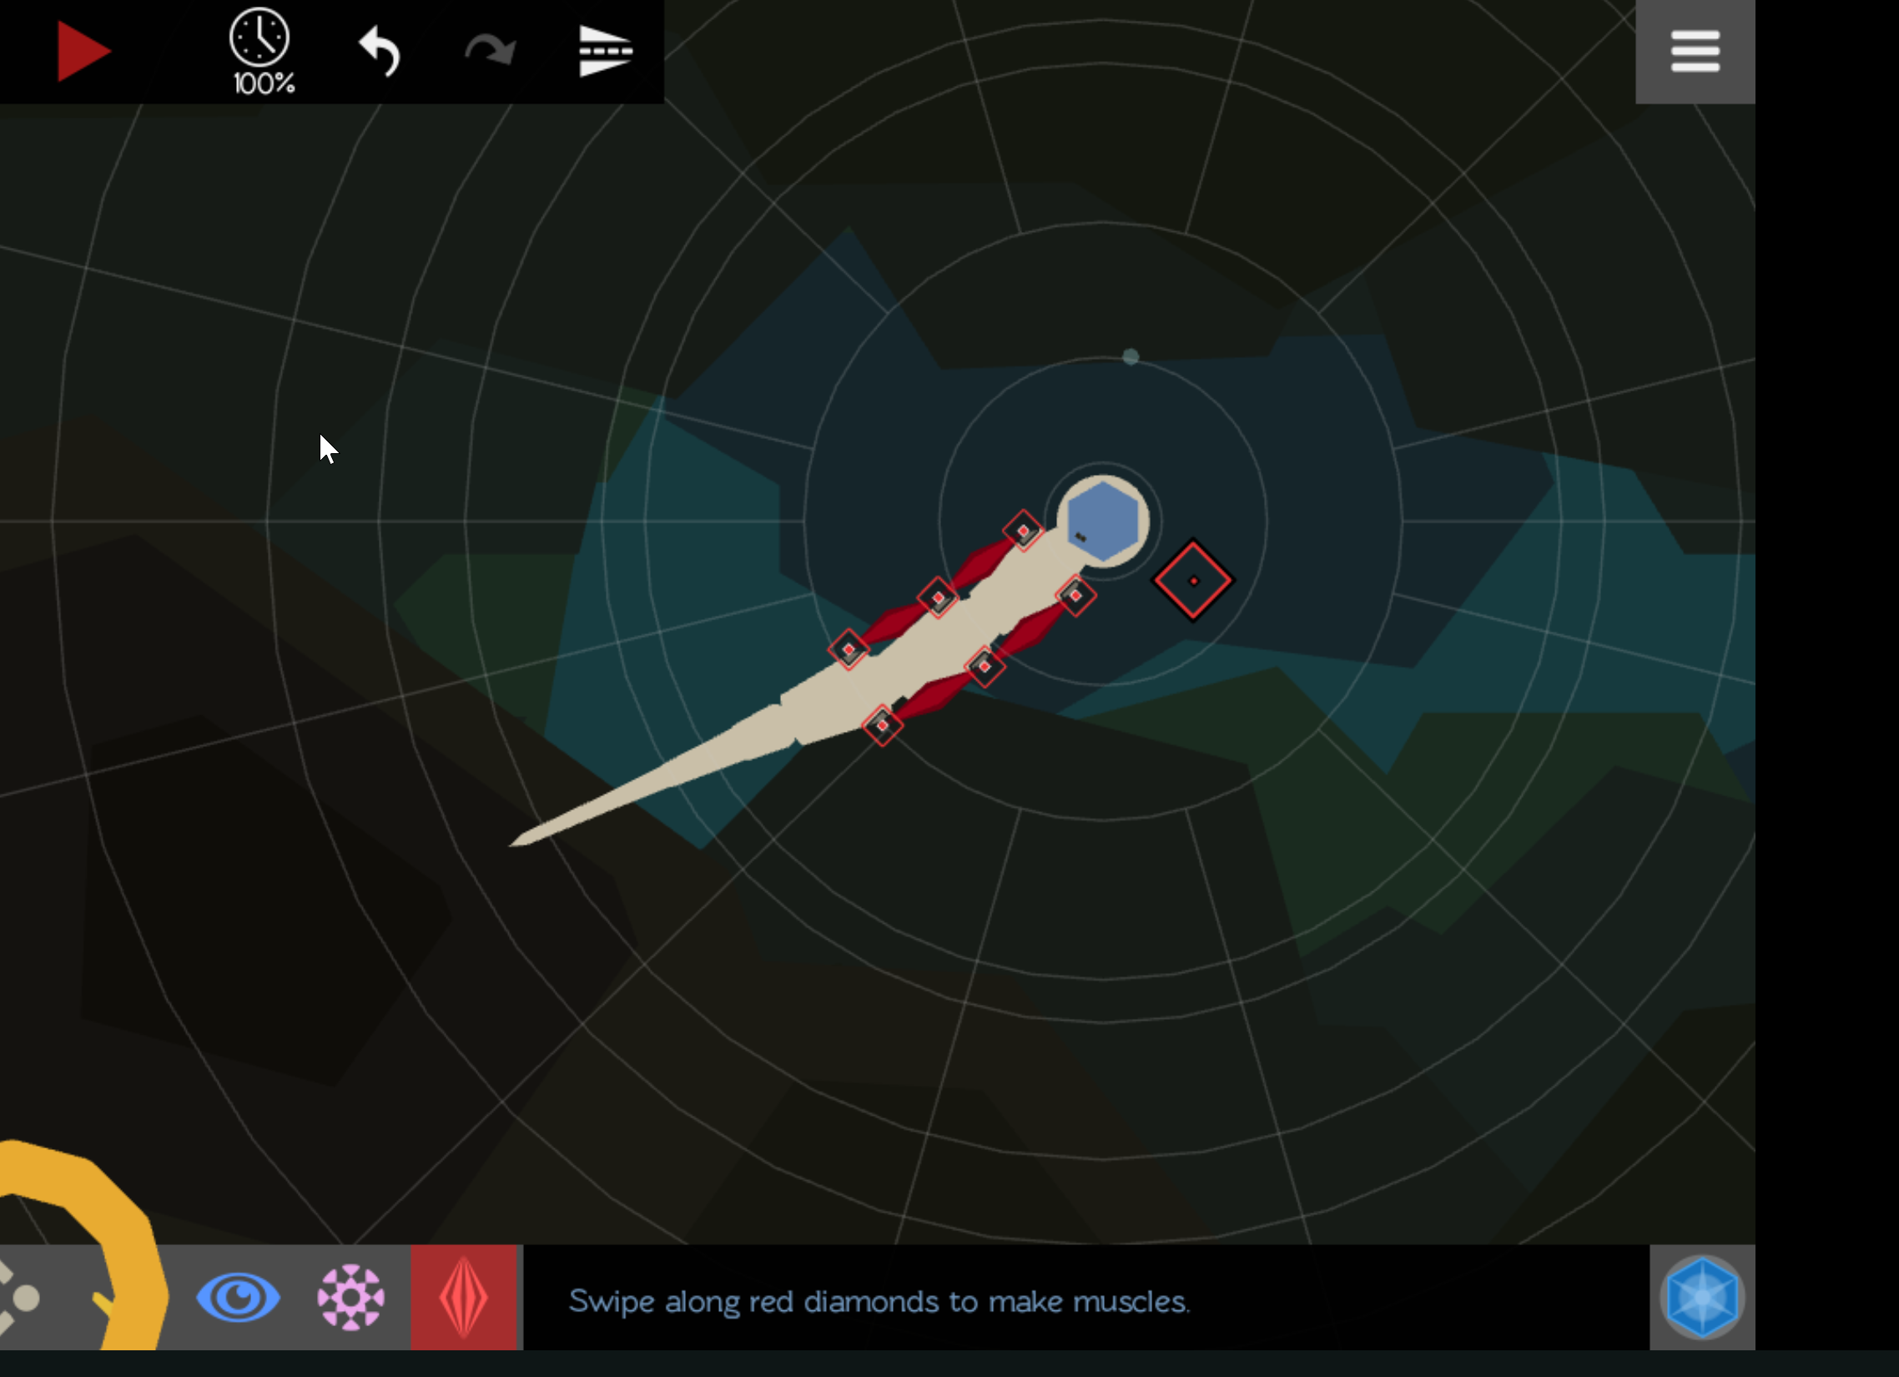
Add muscles

Slide 4
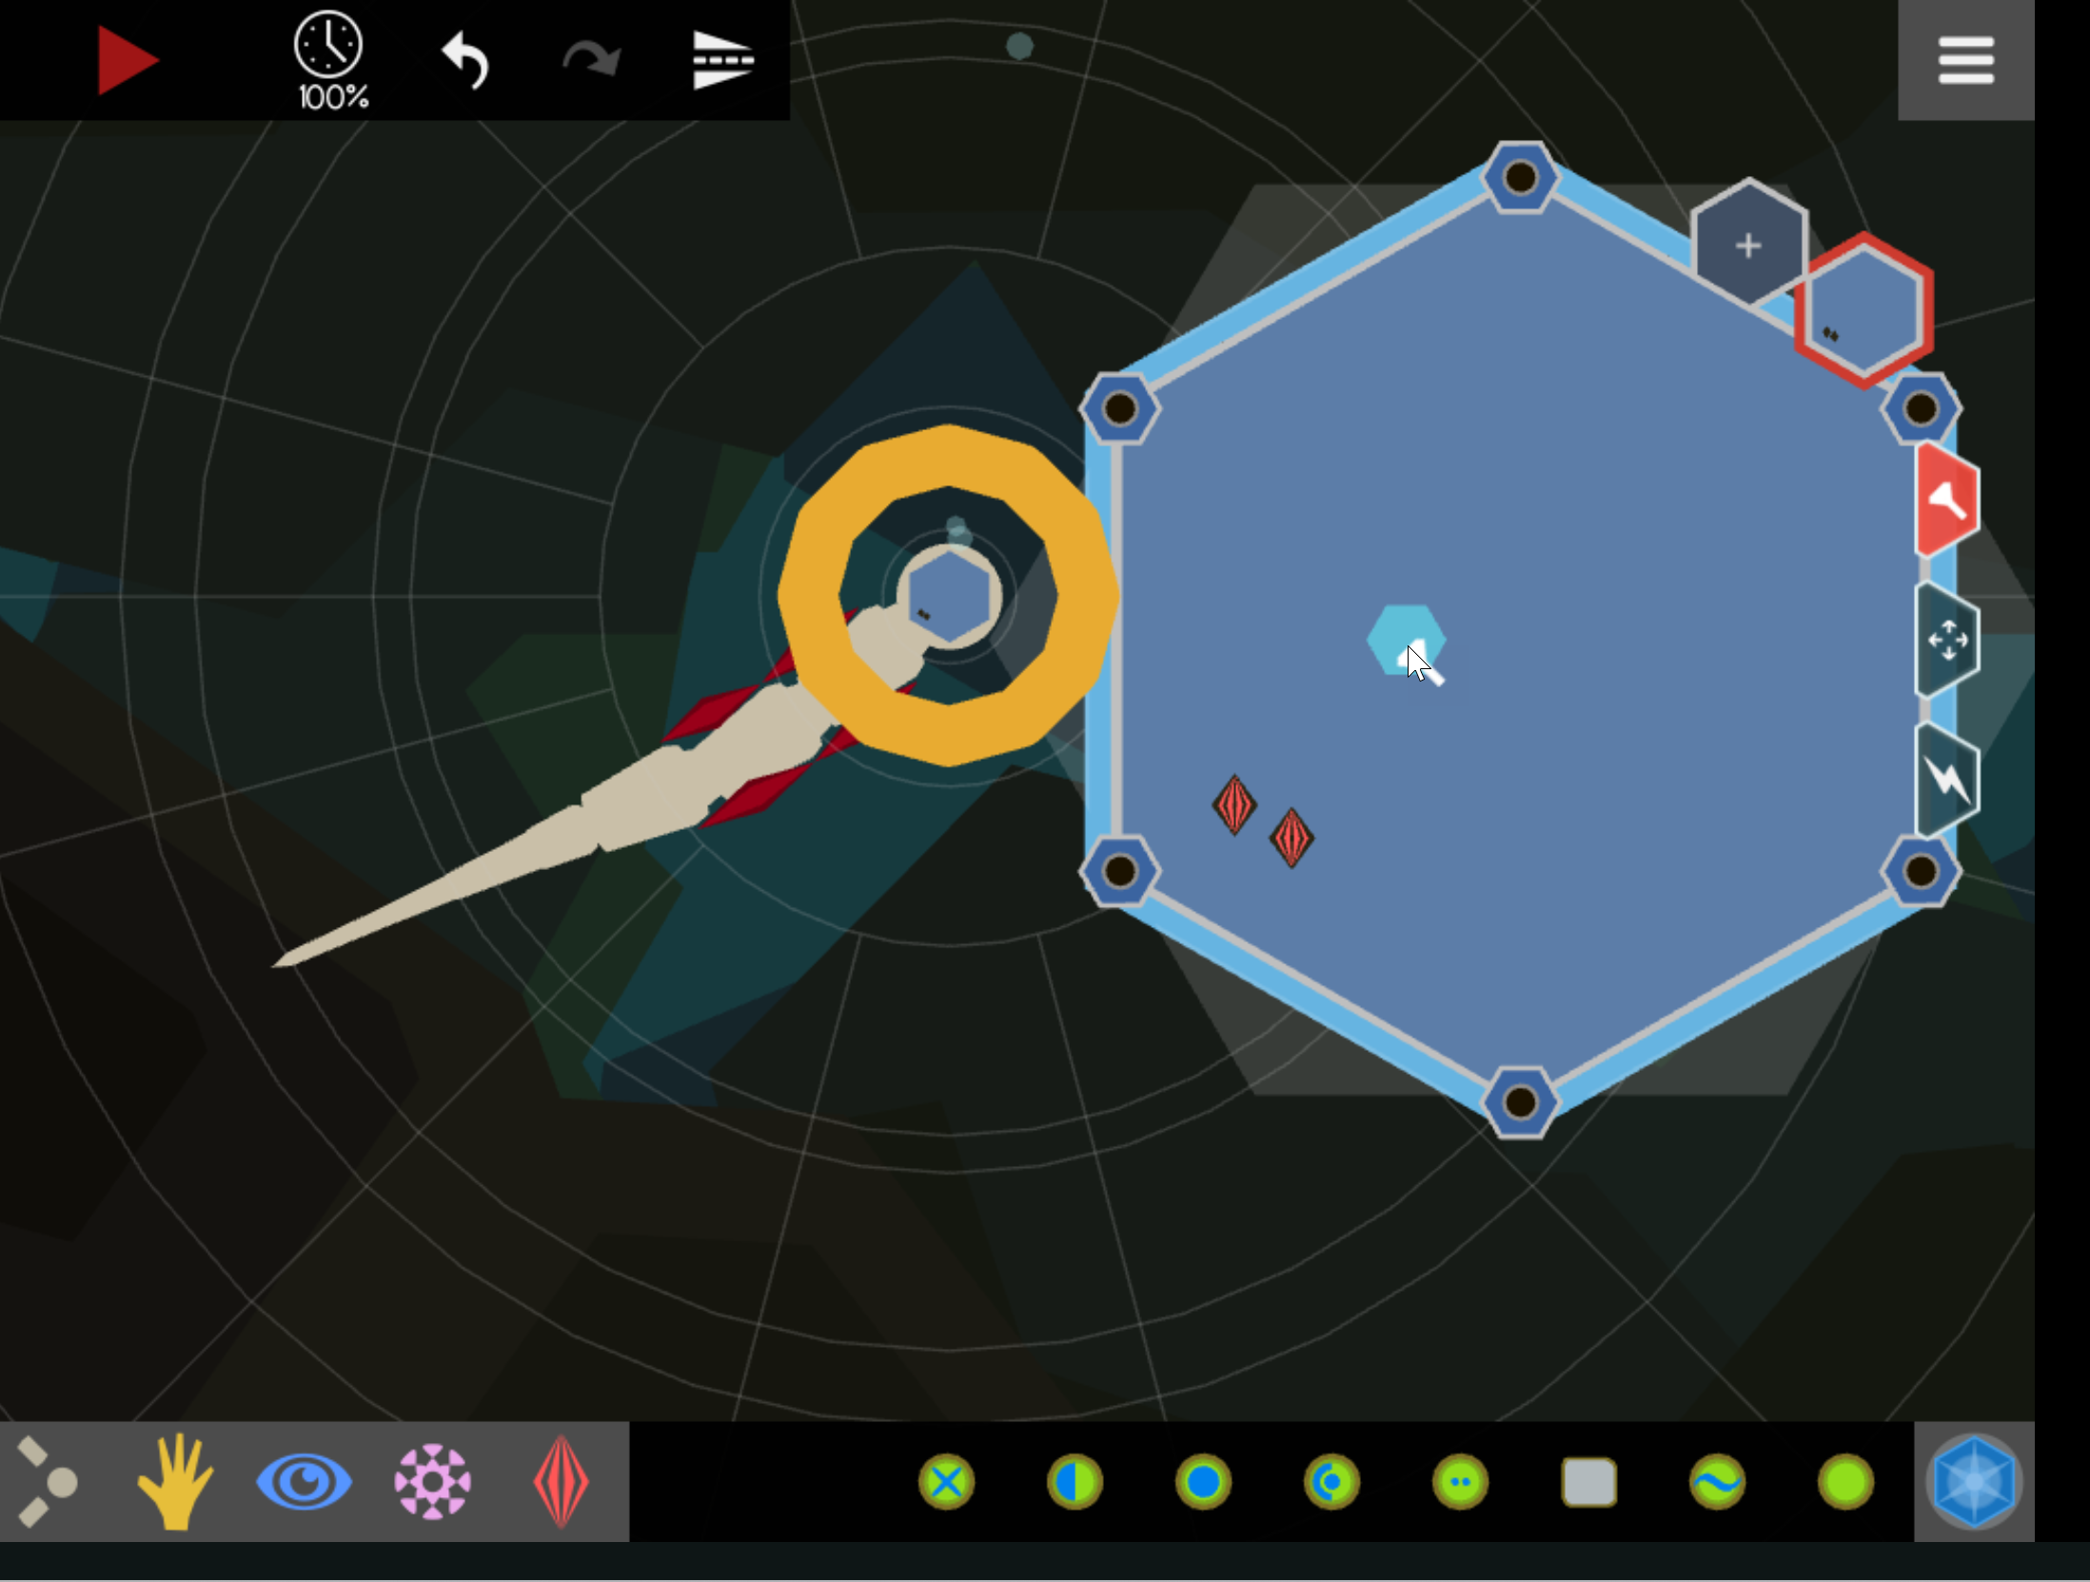
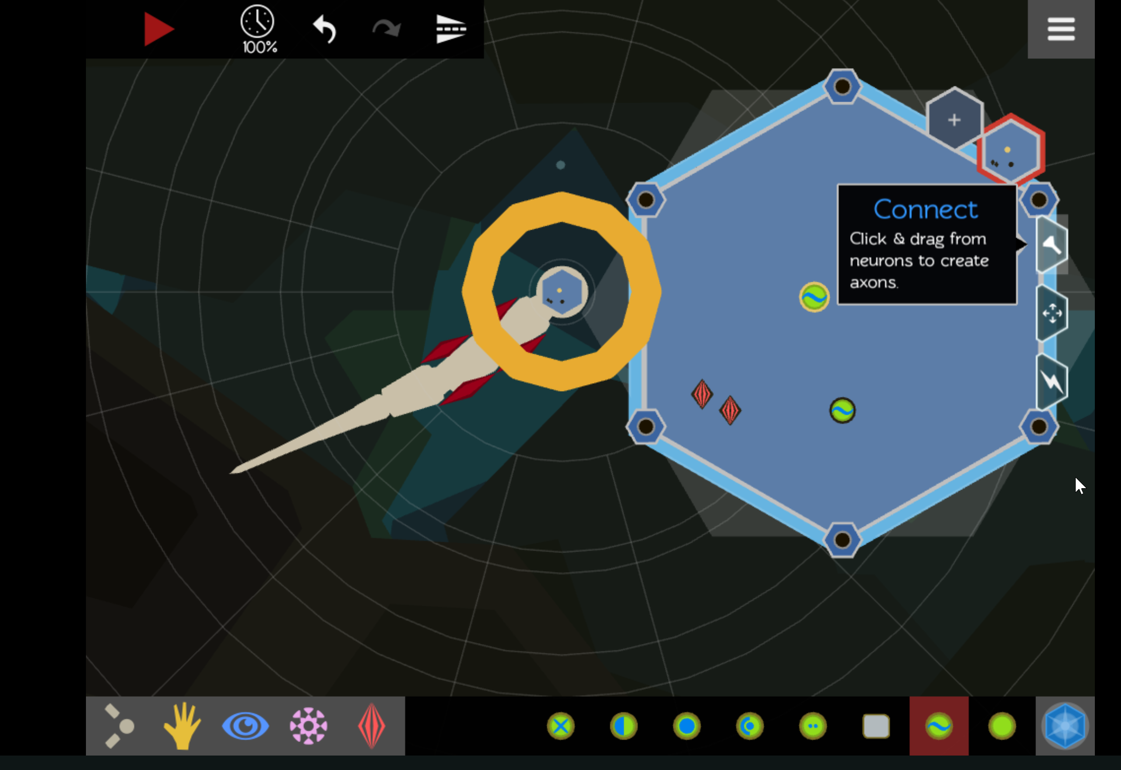
Enter Brain and Add Neurons
Click here
muscles
neurons
Connect
Neurons to muscles

Slide 5
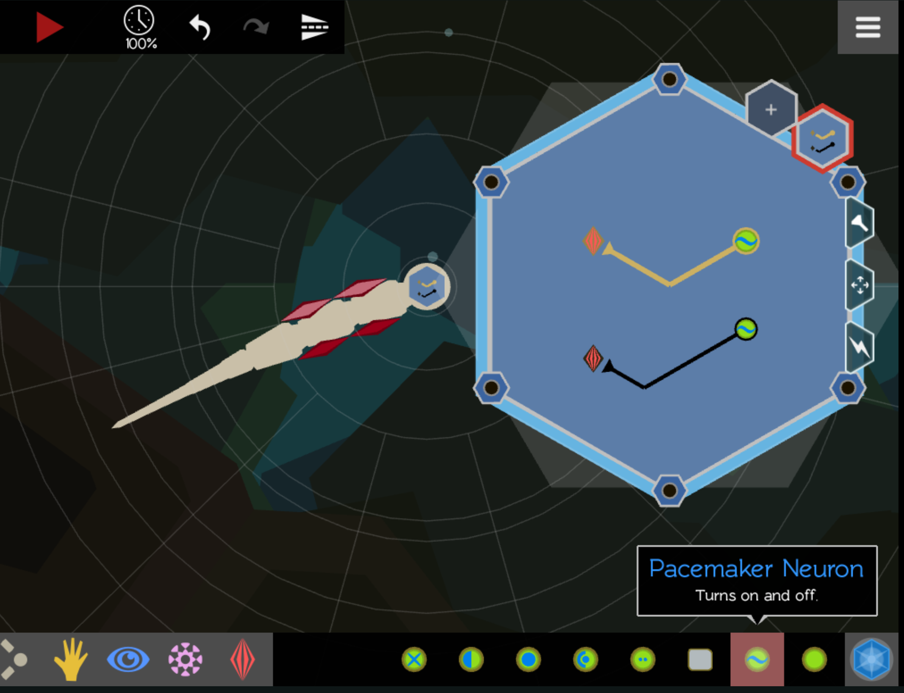
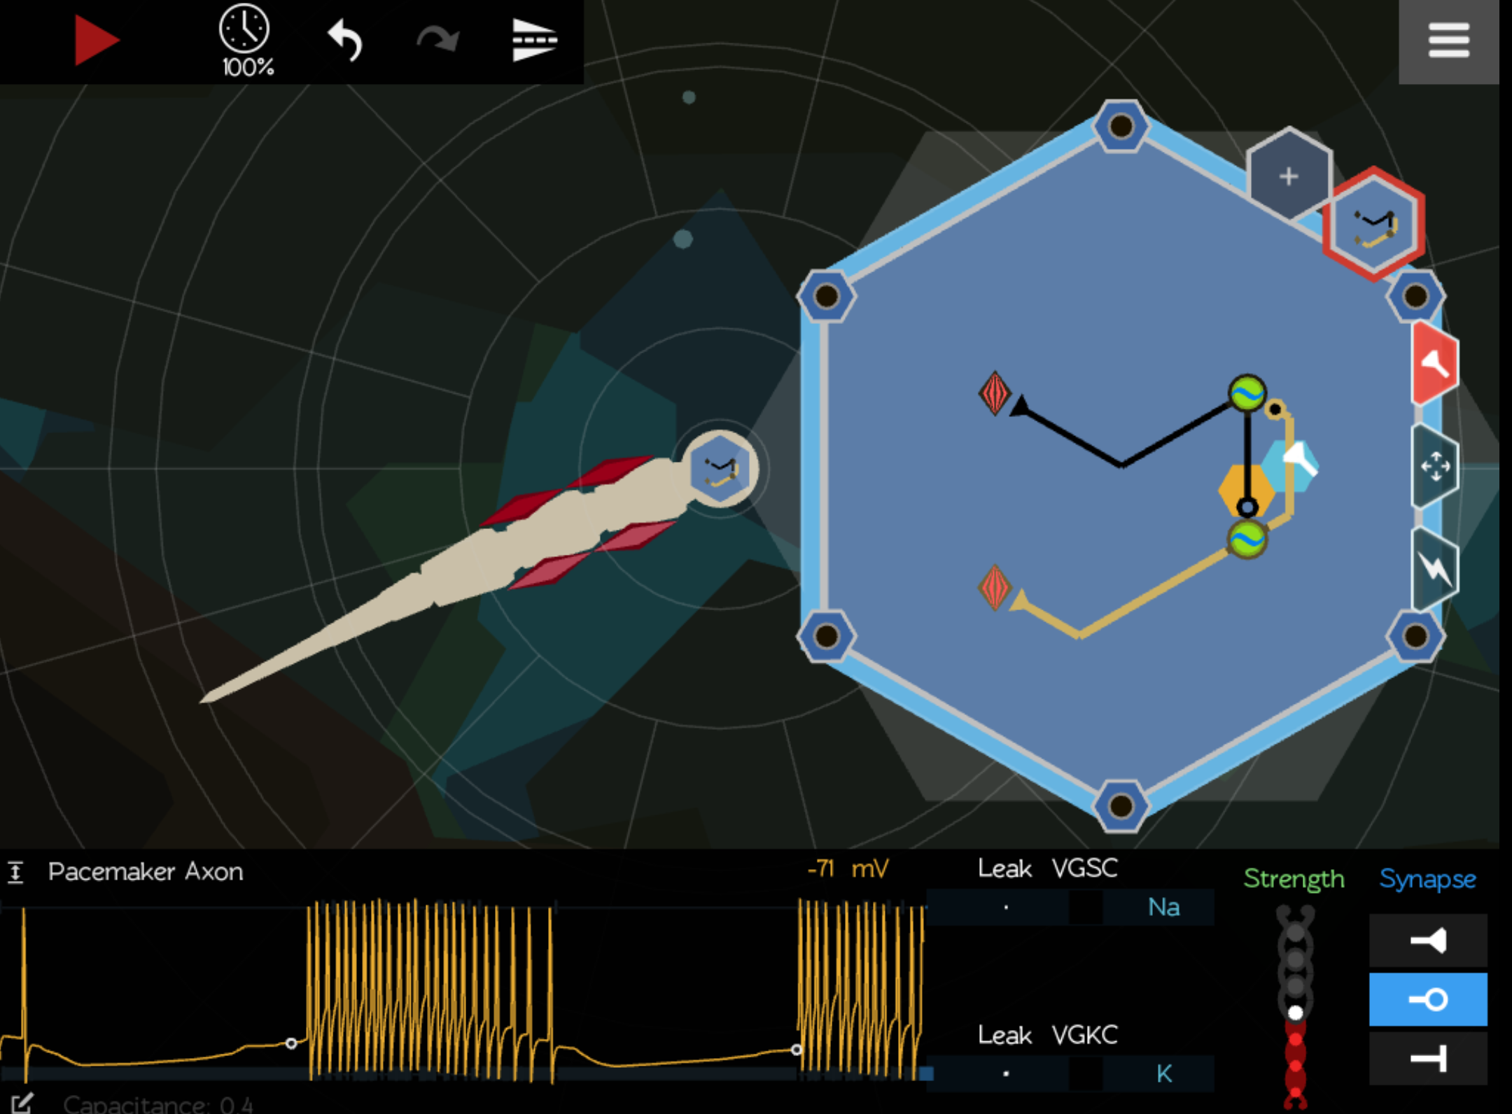
Create Excitatory and Inhibitory Connections
Pacemaker neurons
Reciprocal Inhibitory circuit
Play
Excitatory synapse
Excitation
Inhibitor

Slide 6
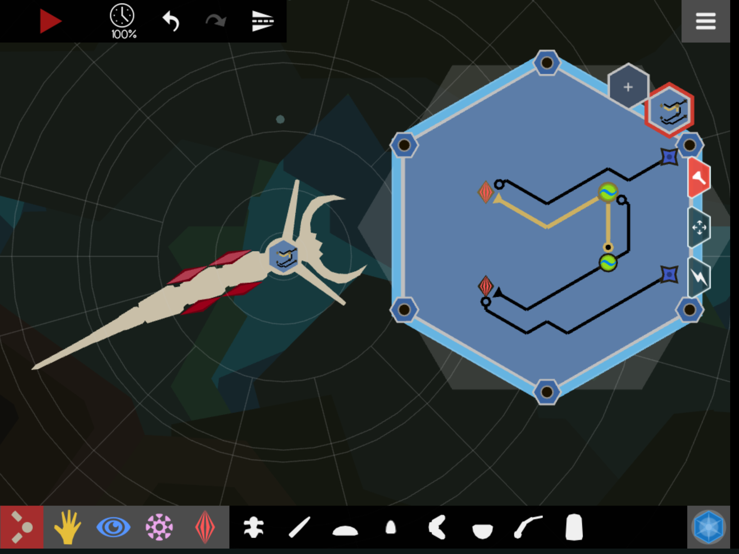
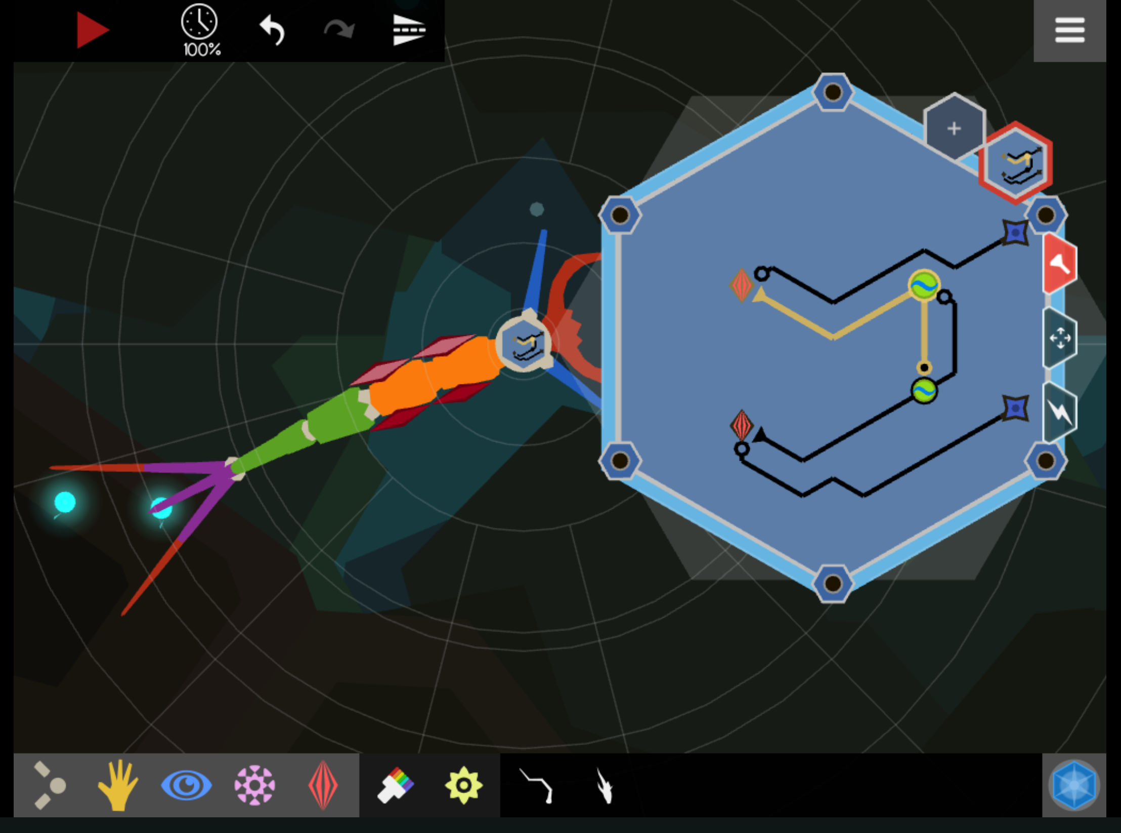
Sensory, Mouth, and Decorations
Whisker neuron
Inhibiting muscle
Mouth
Whisker
Fiber

